Slide 1






































Lecture No: 08

Slide 2
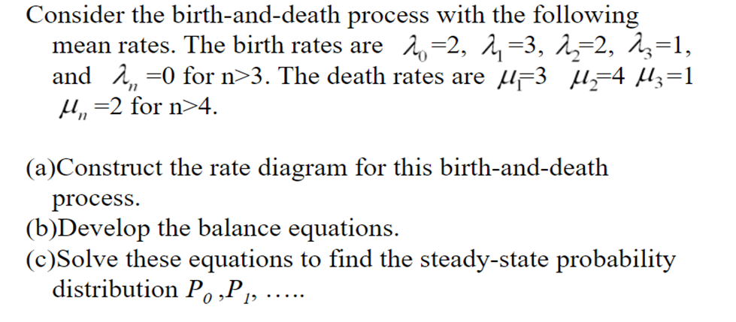








































Slide 3
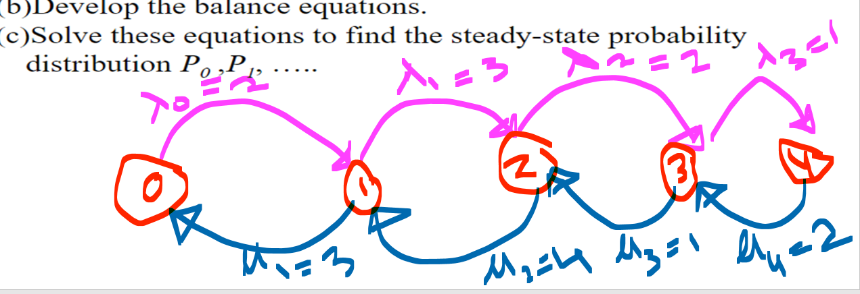























































Slide 4
















































Slide 5




























































Slide 6














































































Slide 7























































Slide 8























Slide 9


















































































Slide 10




































































Slide 11










































Slide 12





























Slide 13






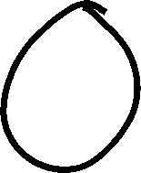







































Slide 14


































Slide 15


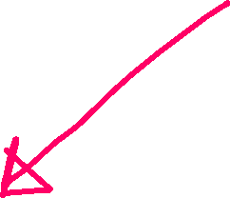


































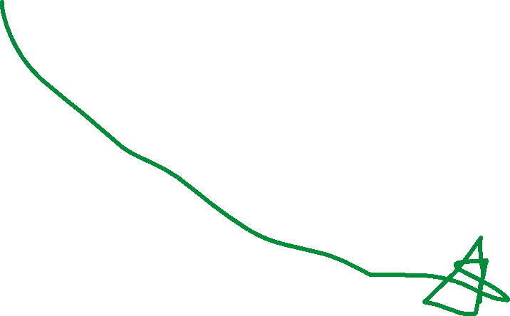







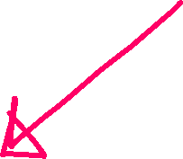




















Slide 16
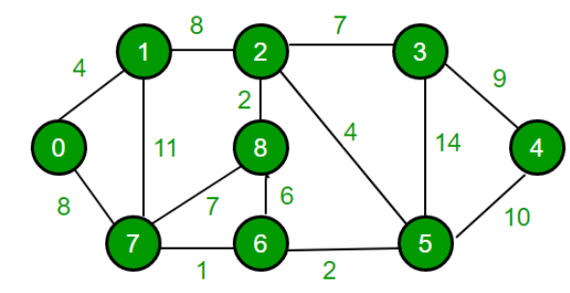
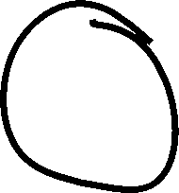

Starting 0
Destination = 4

